Slide 1
A Simple Example
From geometrical model to rendered image

Slide 2
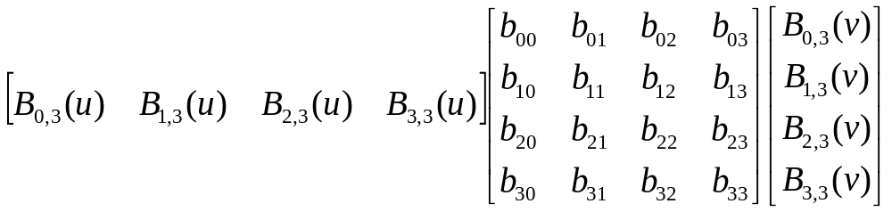
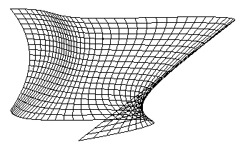
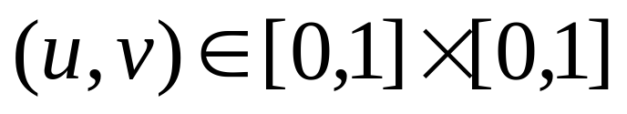
Modeling –Bezier patch

Slide 3
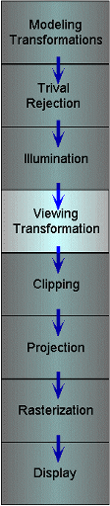
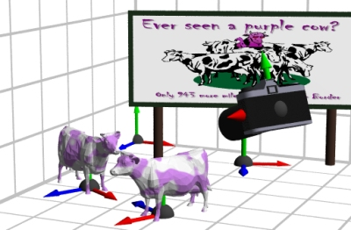
Viewing Transformations
Using a combination of rotations, translations and scales, how to develop a special class of transformations specifically for the purpose of mapping points from world space to eye space?

Slide 4
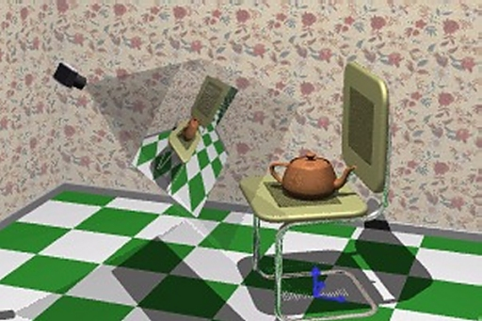
Viewing Transformations
The goal of a viewing transformation is to specify the position and orientation of our 3-D graphics camera in the scene. However, its effect is almost the opposite.

Slide 5
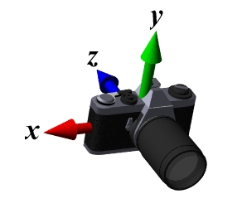
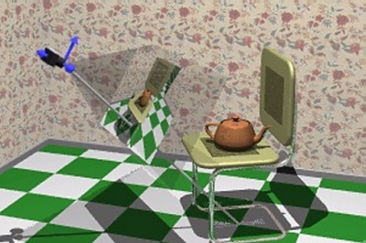
Camera-Centered View
It’s a good choice to reorient the entire scene such that the camera is located at the origin. Moreover, if we align the scene so that its optical axis (the direction it is looking) is along one of the coordinate axes and twist the scene so that the desired up direction is aligned with our camera's up direction we can greatly simplify the clipping and projection steps that follow.

Slide 6
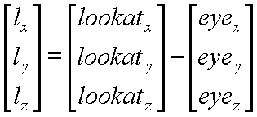

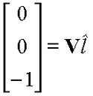
Deriving a Natural Viewing Transform
Consider a vector along the look-at direction:
After normalizing it
We expect our desired rotation matrix to map it to the vector [0, 0, -1]^{T} (Why?).

Slide 7

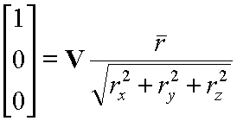
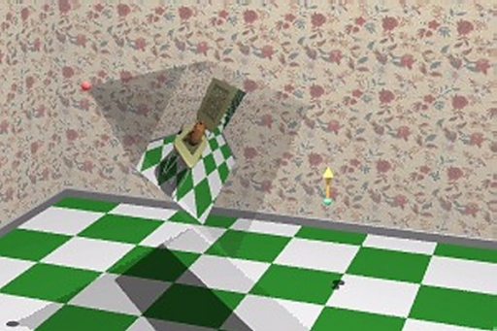

Deriving a Natural Viewing Transform
If we find the cross product between the look-at vector with our up vector, we will get a vector that points to the right.
We expect that this vector when normalized will transform to the vector [1, 0, 0]^{T}.

Slide 8

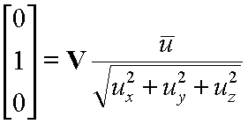
Deriving a Natural Viewing Transform
Finally, from these two vectors we can synthesize a third vector in the up direction.
And this vector, when normalized, should transform to [0, 1, 0]^{T}.

Slide 9
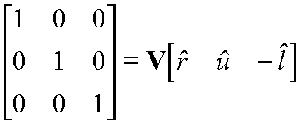
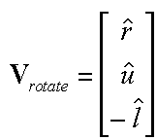
Rotate Transform
Let's consider all of these results together.
Rotations are Easy to Invert

Slide 10
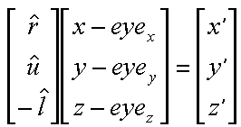
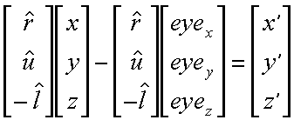
Now for the Translation
The rotation that we just derived is specified about the eye point. However, we are still in world space at this point. In order for the rotation to occur about the correct point if we must first subtract the eye point from any given world space point.
Next we isolate the rotation and translation parts.

Slide 11
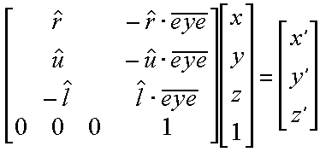
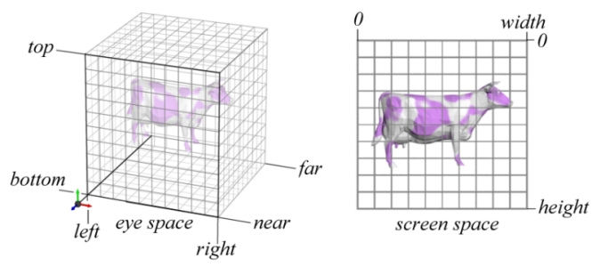
The Viewing Transformation
Finally we can compose the rotation and translation into a single 4 by 4 matrix giving V:

Slide 12
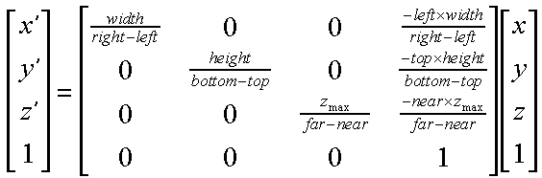
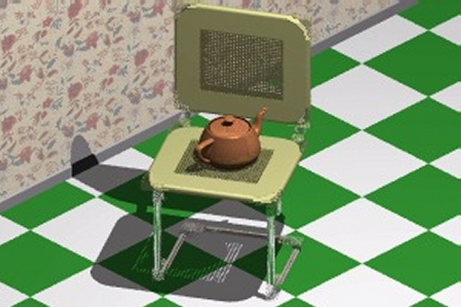
The Viewing Transformation
Orthographic Projection ?

Slide 13
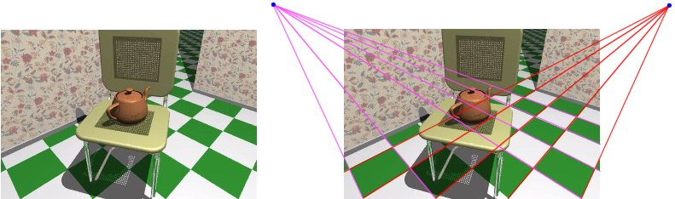
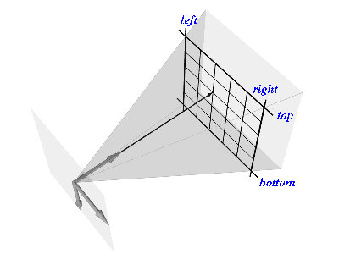
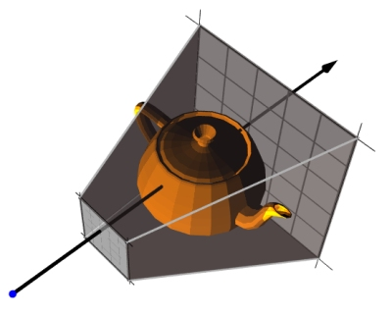
Perspective Projection

Slide 14
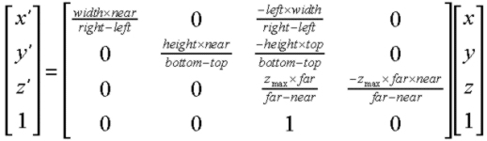
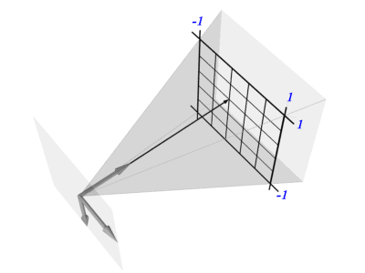
For the purpose of clipping we can modify this transformation so that it is mapped into a canonical space.
Perspective Projection
The following transformation accomplishes the projection and the
conversion to pixels in a single transform.

Slide 15
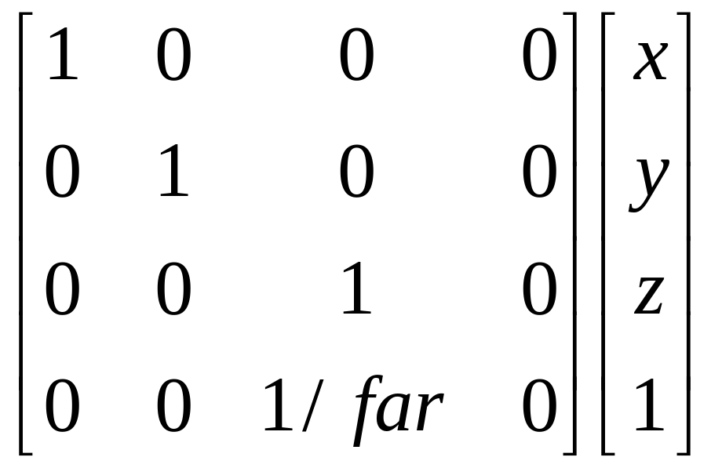

Slide 16
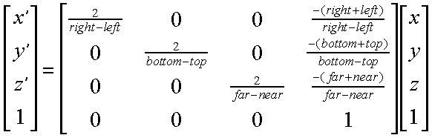
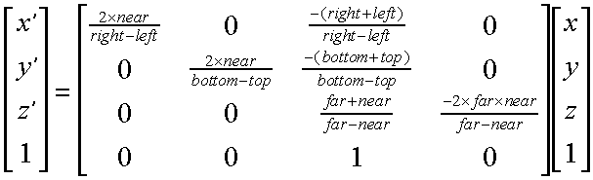
Canonical Perspective Projection
Following is a canonical space mapping for orthographic projections.
Next is a canonical space mapping for perspective projections.

Slide 17
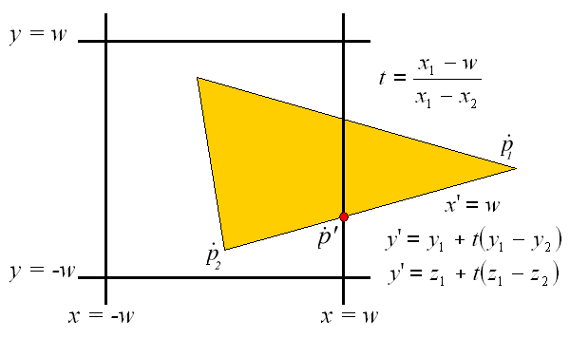
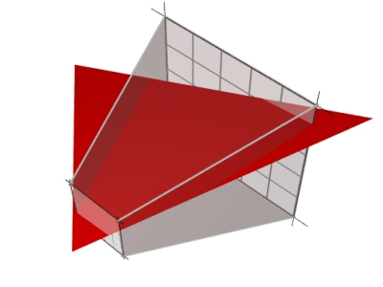
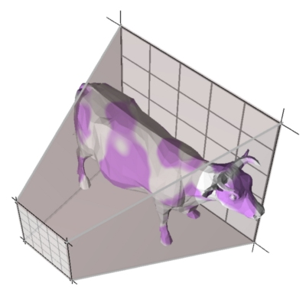
Clipping

Slide 18
An Example Clipper
One of the difficult aspects of clipping is fitting it into a clean conceptual model. Here we'll consider how I added clipping to our Triangle class.
public void Draw(Raster raster) {
int flag = 0;
v0 = vlist[v[0]];
v1 = vlist[v[1]];
v2 = vlist[v[2]];
float near = Vertex3D.getNear();
if (v0.z > Raster.MAXZ) flag += 1;
if (v1.z > Raster.MAXZ) flag += 2;
if (v2.z > Raster.MAXZ) flag += 4; //computes our outcodes.
if (flag == 0) { // entirely inside clipping volume
ScanConvert(raster);
} else
if (flag == 7) { // entirely outside clipping volume
return; }
else { // permute triangle vertices to one of two canonical forms:
// 1. Just v2 outside of clipping volume (flag == 4)
// 2. v1 and v2 outside of clippling volume (flag == 6)
if (flag == 1) { Vertex3D tv = v0; v0 = v1; v1 = v2; v2 = tv; flag = 4; }
else if (flag == 2) { Vertex3D tv = v0; v0 = v2; v2 = v1; v1 = tv; flag = 4; }
else if (flag == 3) { Vertex3D tv = v0; v0 = v2; v2 = v1; v1 = tv; }
else if (flag == 5) { Vertex3D tv = v0; v0 = v1; v1 = v2; v2 = tv; }

Slide 19
Actual Clipping Code
float t;
v0 = normalize(v0); v1 = normalize(v1); v2 = normalize(v2);
if (flag == 4) { // hither clipping yields 2 triangles
float tx = v2.x, ty = v2.y, tz = v2.z, tw = v2.w;
int trgb = rgb[2];
t = (near - v1.w)/(tw - v1.w);
Vertex3D.lerp(v2, v1, v2, t);
rgb[2] = rgbLerp(rgb[1], trgb, t);
v0 = normalize(v0); v1 = normalize(v1); v2 = normalize(v2);
ClipYon(raster);
v0 = normalize(v0);
v1.x = v2.x; v1.y = v2.y; v1.z = v2.z;
v1.w = v2.w;
rgb[1] = rgb[2];
v2.x = tx; v2.y = ty; v2.z = tz; v2.w = tw;
t = (near - v0.w)/(tw - v0.w);
Vertex3D.lerp(v2, v0, v2, t);
rgb[2] = rgbLerp(rgb[0], trgb, t);
v0 = normalize(v0); v2 = normalize(v2);
ClipYon(raster);
} else

Slide 20
The Other Case
} else { // hither clipping yields one triangle
t = (near - v0.w)/(v2.w - v0.w);
Vertex3D.lerp(v2, v0, v2, t);
rgb[2] = rgbLerp(rgb[0], rgb[2], t);
t = (near - v0.w)/(v1.w - v0.w);
Vertex3D.lerp(v1, v0, v1, t);
rgb[1] = rgbLerp(rgb[0], rgb[1], t);
v0 = normalize(v0);
v1 = normalize(v1);
v2 = normalize(v2);
ClipYon(raster);
}
}
}

Slide 21

Visibility
Back-Face Culling
Painter's Algorithm
Depth Buffering
DSP Tree

Slide 22
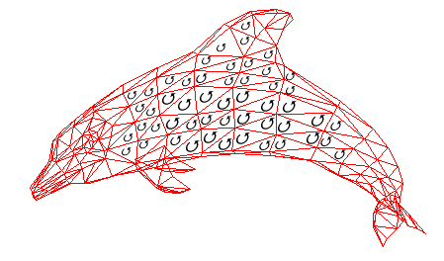
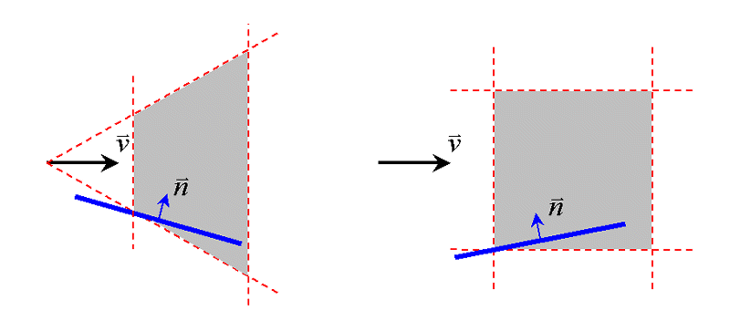
Removing Back-Faces
foreach face F of object
if (n . v > 0)
throw away the face

Slide 23
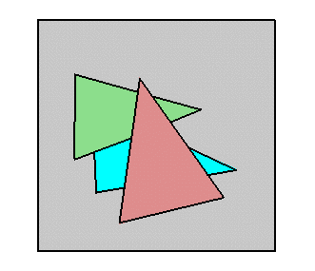
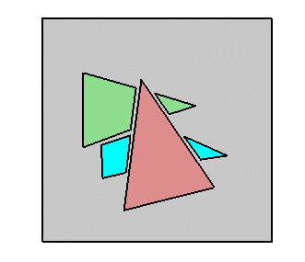

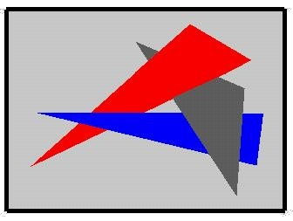
A Painter's Algorithm
Problem!

Slide 24
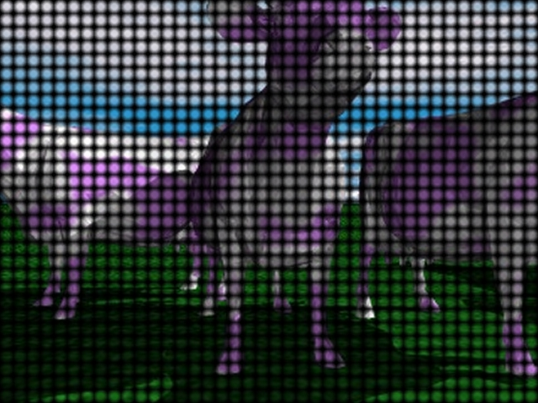
Depth(Z-) Buffering
Algorithm:
Cast a ray from the viewpoint through each pixel to find the closest surface
Rendering Loop:
set depth of all pixels to ZMAX
foreach primitive in scene
determine pixels touched
foreach pixel in primitive
compute z at pixel
if (z < depth) then
pixel = object color
depth = z
endif
endfor
endfor

Slide 25
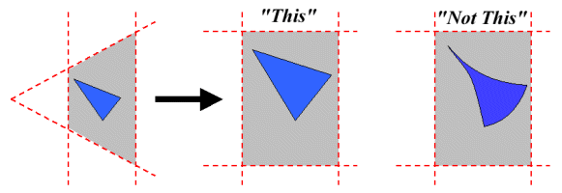
What Exactly Gets Stored
in a Depth-Buffer?
There are two important considerations.
  The mapping is from 3D (Affine) to 3D (Projective)
  The mapping is linear (in general, planes map to planes)

Slide 26

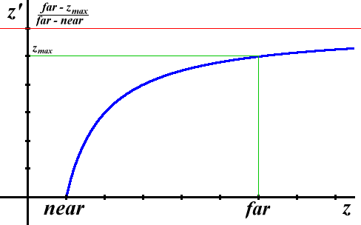
Computing the "Z" Term
We get the following expression for z' from our projection matrix:
This mapping of z values is non-linear:

Slide 27
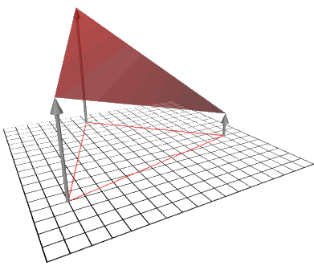

Interpolating Z
Preserving the linearity of the space allows us to use our plane equation method for interpolating values of z in the interior of the triangle.
Thus, we can used our handy formula for interpolating parameters within a triangle.

Slide 28
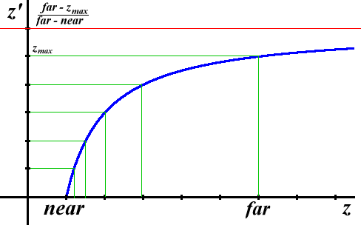
Monotonic Z values
We need to be careful when reading the values out of a z-buffer and interpolating them. Eventhough, our interpolated values of z lie on a plane, uniform differences in depth-buffer values do no correspond to a uniform differences in space.
However, our z-comparisions will still work because this parameter mapping, while not linear, is monotonic.
Note that when the z values are uniformly quantized the number of discrete discernable depths is greater closer to the near plane than near the far plane. Is this good?

Slide 29
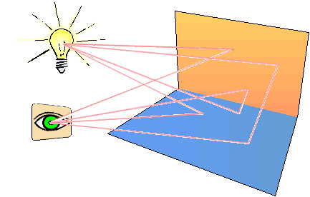
Illumination Models
Computer Graphics Jargon:
  Illumination Models:
  Empirical - simple formulations that approximate observed phenomenon
  Physically-based - models based on the actual physics of light's interactions with matter
  Illumination - the transport of luminous flux from light sources between points via direct and indirect paths
  Lighting - the process of computing the luminous intensity reflected from a specified 3-D point
  Shading - the process of assigning colors to pixels

Slide 30
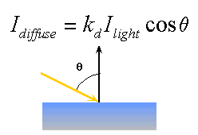
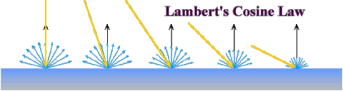

Computing Diffuse Reflection
The angle between the surface normal and the incoming light ray is called the angle of incidence and we can express a intensity of the light in terms of this angle.
The I_{light} term represents the intensity of the incoming light at the particular wavelength (the wavelength determines the light's color). The k_{d} term represents the diffuse reflectivity of the surface at that wavelength.
In practice we use vector analysis to compute cosine term indirectly. If both the normal vector and the incoming light vector are normalized (unit length) then diffuse shading can be computed as follows:

Slide 31
Enjoy your graphics

